Slide 1

Final Project Data Analysis
Olivia Grill
American Public University System
Math239:Data Analysis
Professor Anne Geraci
March 28th, 2021

Slide 2
Interquartile Range
Gender n | Minimum | Q1 | Median | Q3 | Maximum
Female 112 | 122 | 157 | 160.5 | 168 | 229
Male 114 | 141 | 168 | 177 | 180.225 | 196

Slide 3
Other Findings
Gender | Mean | Standard Deviation | Range | Interquartile Range (IQR)
Female | 161.9134 | 13.0148 | 72 | 11
Male | 173.4675 | 11.3990 | 55 | 12.225

Slide 4
Outliers
[ Q1-IQR(1.5) , Q3+IQR(1.5) ]
Male
[168 - 12.225(1.5) , 180.225 + 12.225(1.5)]
IQR = [149.6625 , 198.5625]
Female
[ 157- 11(1.5) , 168 + 11(1.5) ]
IQR= [140.5 , 184.5]

Slide 6
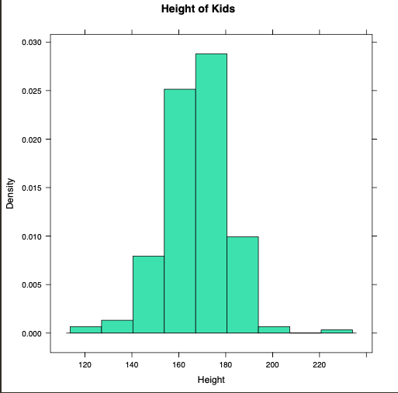
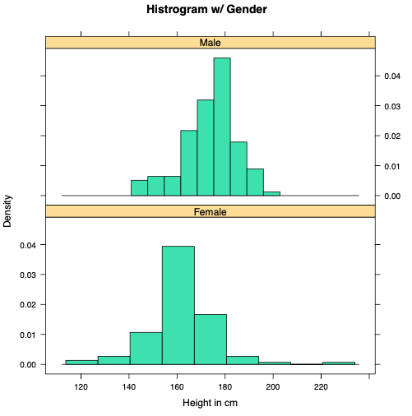

Slide 7
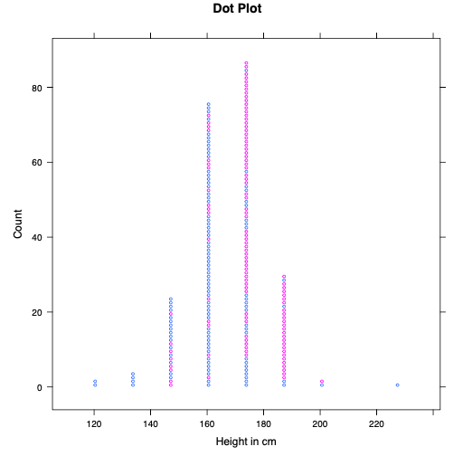
Blue-Male
Pink-Female

Slide 8
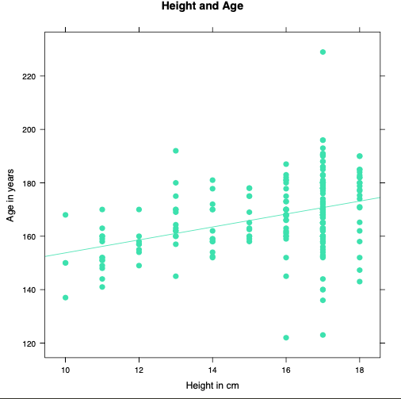

Slide 9
